Slide 1









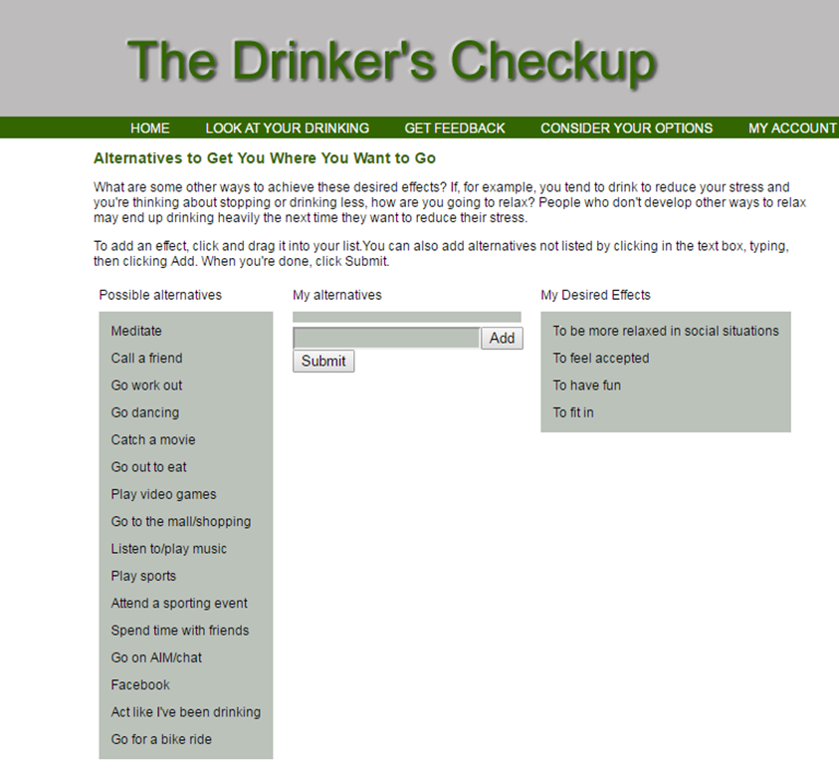
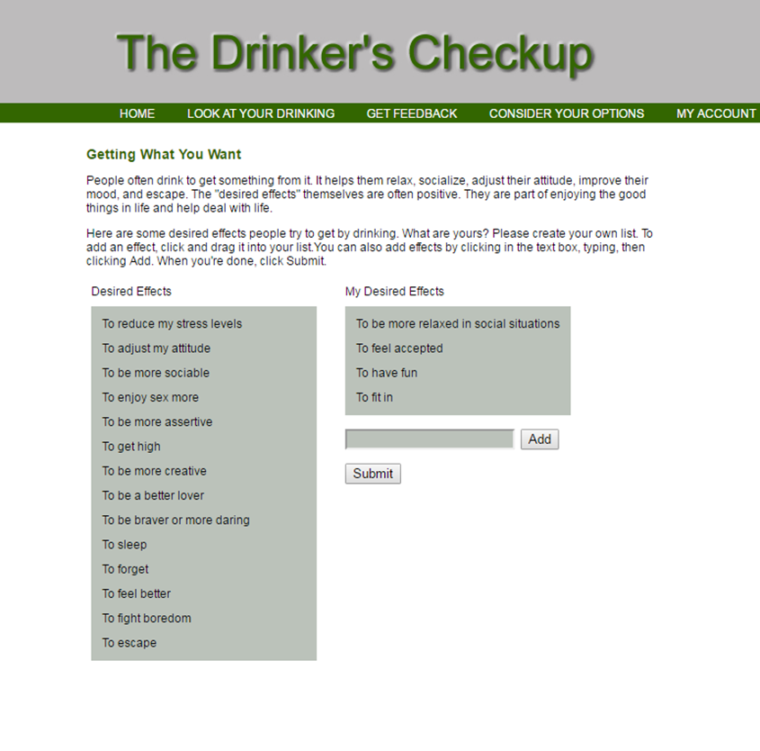

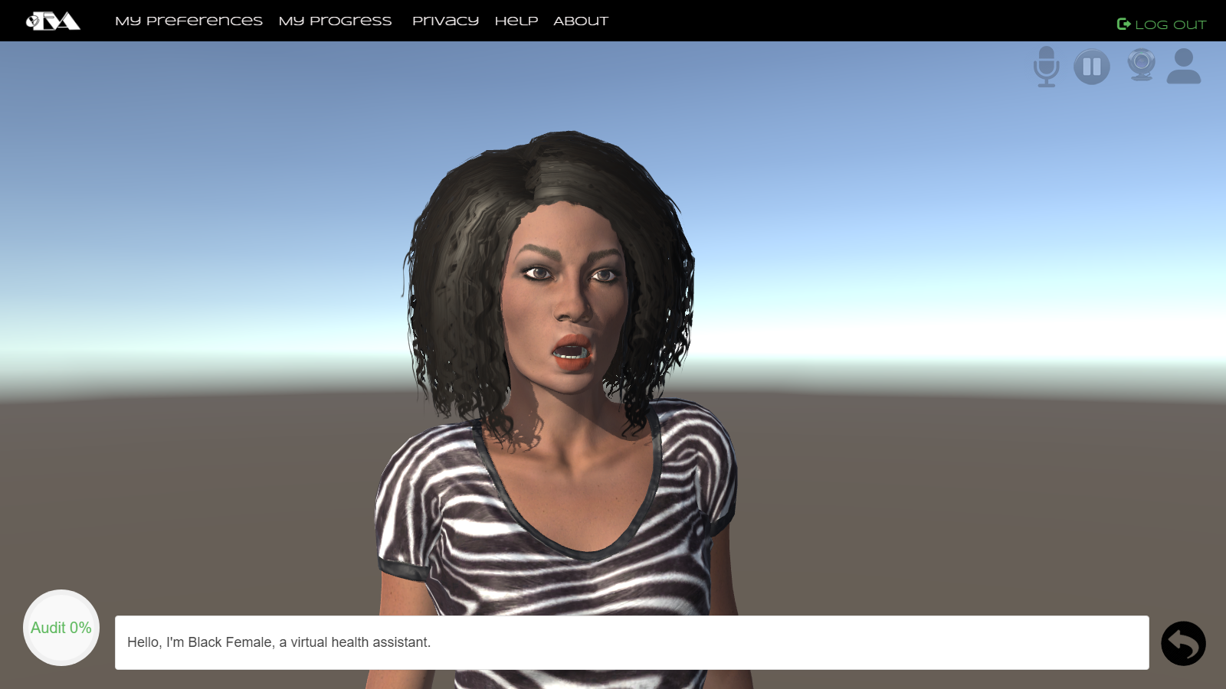
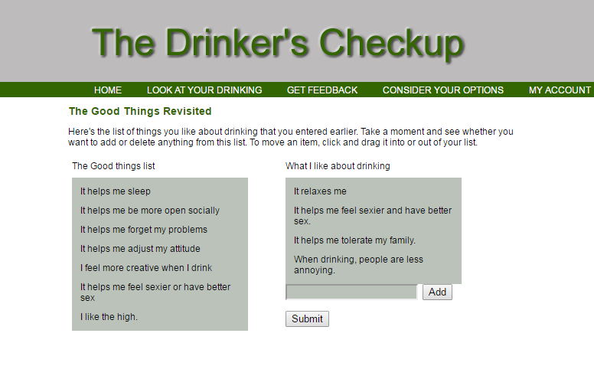

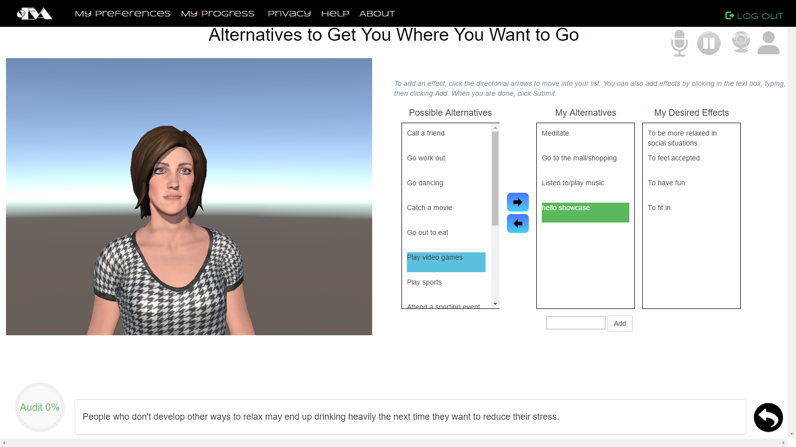
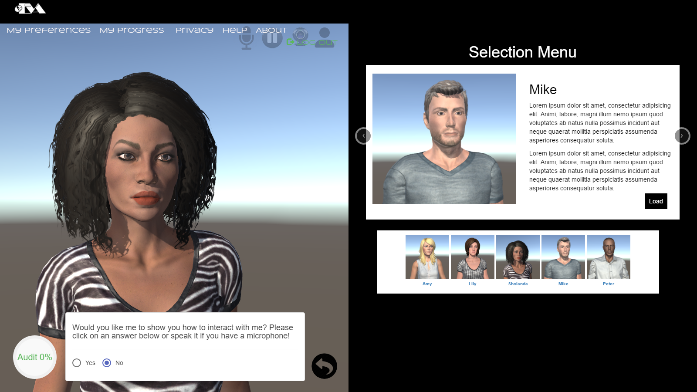
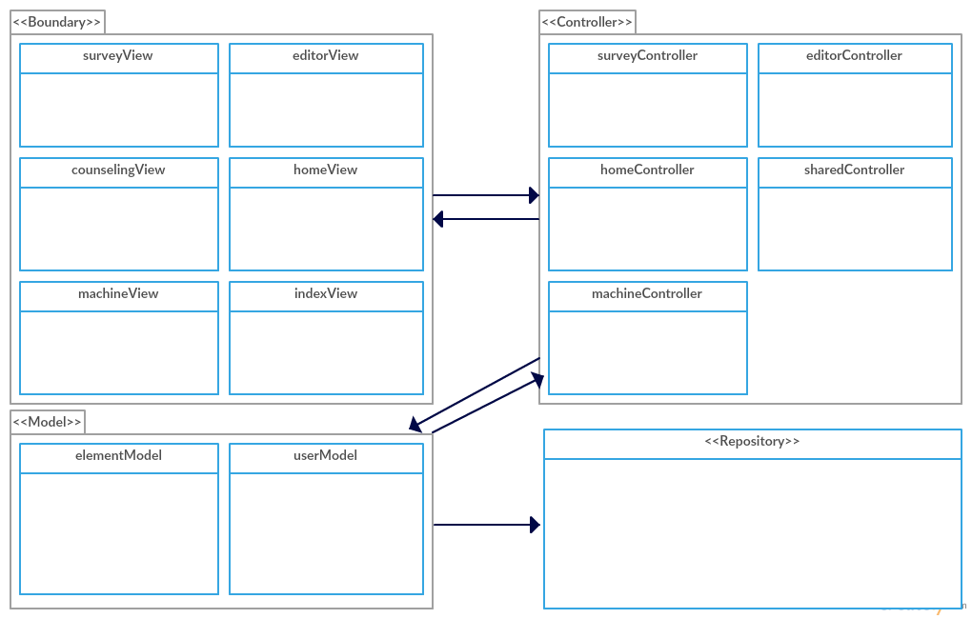
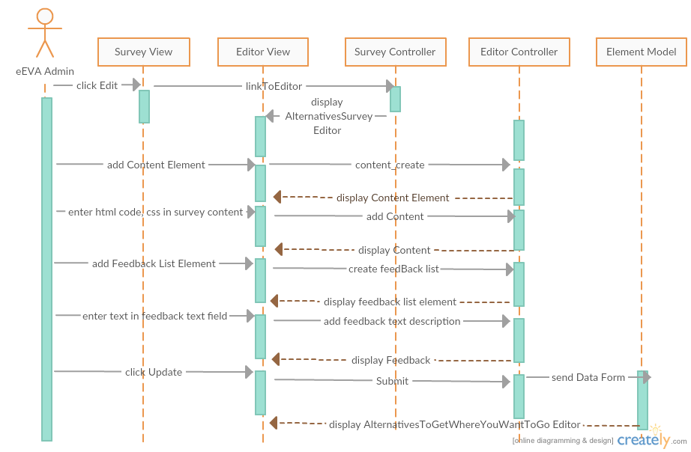
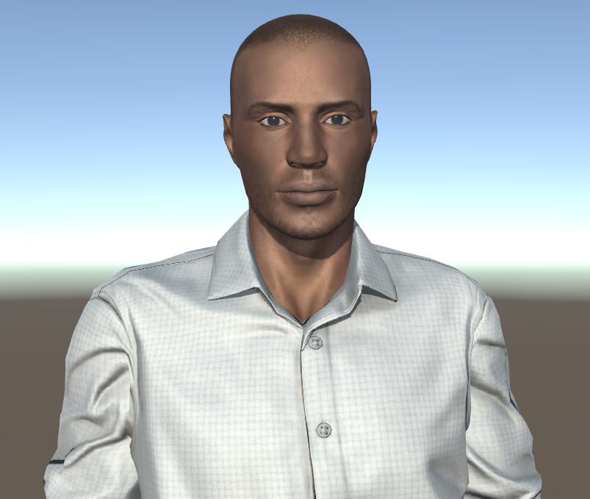


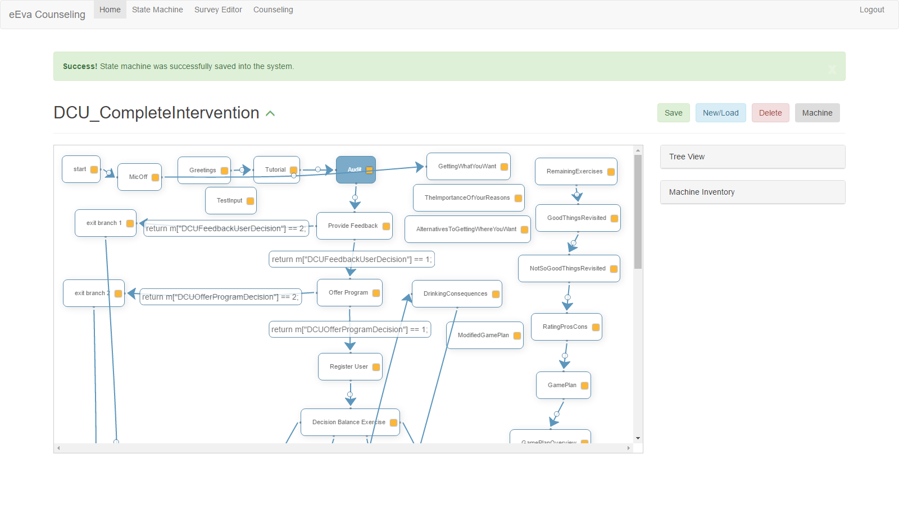

eEVA Data Generation and User Results Analysis v2.0
Senior Project, 2017, Spring
Student: Andy Regueira, Florida International University
Product Owner: Christine Lisetti, Florida International University
Mentor: Mohsen Taheri, Stephanie Lunn, Florida International University
Instructor: Masoud Sadjadi, Florida International University
Problem
Solution
Current System
More often that not, people get tired of reading big chunks of text displayed on the screen that convey a lot of information. That is why eEVA, attempts to find a more convenient, and entertaining way of interacting with users that suffer from alcohol addiction, through virtual health counselors. However, in order to further aid the improvement of this application, there are still features, surveys, and required text only content, from the original version of the Drinker’s Checkup (DCU), that must be integrated into the latest version.
Addition of missing text only surveys from DCU, through survey editor.
Integration of surveys by adding states to the state machine.
Modification of visual appeal of survey views.
Selection menus to choose the counselor of your choice.
eEVA makes use of 5 virtual 3D health counselors to advice users.
Users may take many surveys, to help with different alcohol related problems.
A state machine controls the avatars responses.
Missing a part of the original text only based Drinkers Checkup.
Users may get feedback and see survey results.
Screenshots
Original Text-based system
eEVA v2.0
Requirements
Implementation
System Design
Implementation of in session selection menu for virtual health counselors.
Loading screen, to ensure counselors are only displayed when Unity WebGL has finished loading.
Change in look and feel of surveys, as well as addition of directional arrows to aid the user with answers selection.
Solutions were designed using MEAN stack.
The screen loader was created using CSS properties.
In session selection menu, makes use of Html, CSS, and Angular.
Surveys, all share the same CSS properties for consistency and reusability.
Each implementation closely follows the MVC architecture, and uses the necessary controller and service to achieve the desired results.
Counseling Intervention Engine Flow Chart:
eEVA v2.0 class-min-view
Object Design
Sequence Diagram for User Story #389_EditDCU_AlternativesSurvey:
Verification
Example Test Cases:
Test Case 3 (sunny)
Purpose: To test the user would be able to move things from one list to another.
Precondition: The user must be logged in and on the counseling view with the GettingWhatYouWant survey loaded.
Input: The user clicks one of the items from the Desired Effects list.
Expected Result: The clicked element in the list moves to the My Desired Effects
Actual Result: Actual result was found to be the expected result.
Status: PASSED
Test Case 4 (rainy)
Purpose: To test that if the user leaves the add text field blank and clicks the Add button, nothing happens.
Precondition: The user must go through Test Case 3 Preconditions.
Input: The user clicks Add Button without having typed anything to add to the My Desired Effects list, in hopes of finding a bug and crashing the page. Mwhaha Evil User.
Expected Result: Nothing happens. The malicious user is disappointed.
Actual Result: Actual result was found to be the expected result.
Status: PASSED
Summary
All of the content from the original Drinkers Checkup has been added. eEVA now uses selection menus to help users choose their preferred counselors, as well as a more fresher and user friendly interface.
User
MongoDB
Acknowledgement
The material presented in this poster is based upon the work supported by my product owner Christine Lisetti and the Affective Social Computing Laboratory (http://ascl.cis.fiu.edu/). I am thankful for the help that I have received from my group member Emmanuel Henley and the Visage lab team.
Notes:
1

